Slide 1
Historical Sales of Walmart Store
—— Xiuhan Li, Enbo Tian, Ziyang Xu
Team 6
DS 502/MA 543

Slide 2
Outline
Introduction
Data Exploration
Feature Engineering
Model
Conclusion

Slide 3
Introduction
Data
Historical data for 45 Walmart store located in different regions that covers sales from 2010-02-05 to 2012-11-01.
Data shape
8 features, 6435 records.
Goal
predict the weekly sale.
Task
Regression
Models
Linear regression, Decision Tree Regressor, Random Forest Regressor.

Slide 4
Data Exploration
Store: the store number
Date: the week of sales
Holiday_Flag: whether the week is a special holiday week
Temperature: Temperature on the day of sale
Fuel_Price: Cost of fuel in the region
CPI – Prevailing: consumer price index
Unemployment: Prevailing unemployment rate
Weekly_Sales: sales for the given store

Slide 5
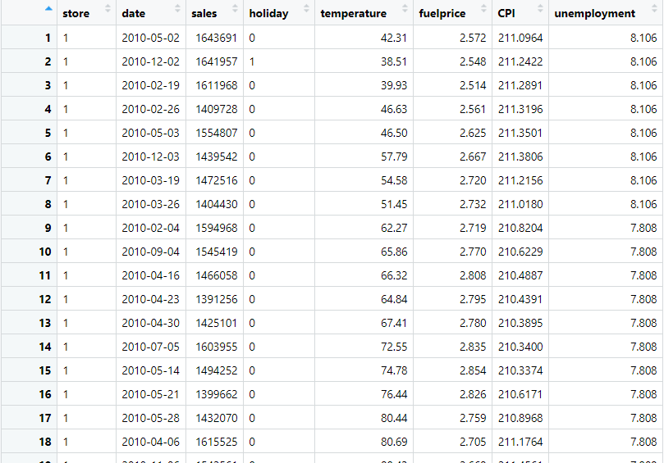
Dataset

Slide 6
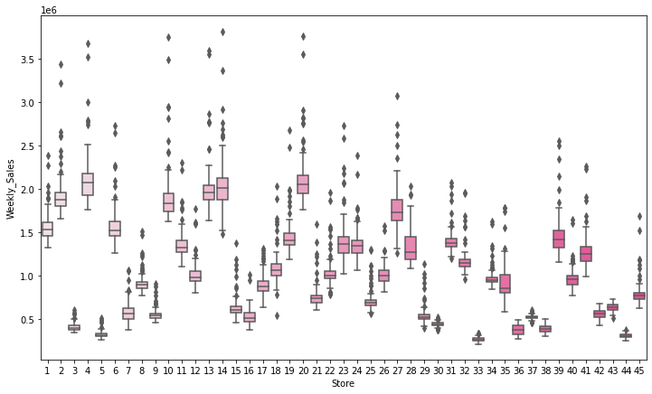
Weekly Sales - Store
Boxplot of weekly sales and store

Slide 7
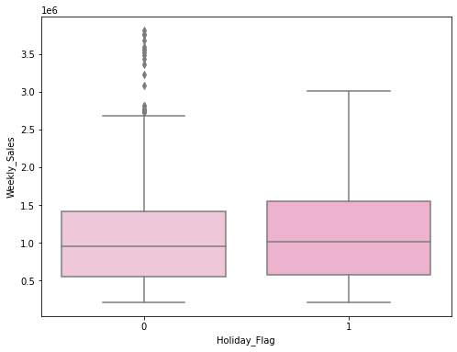
Weekly Sales – Holiday Flag
Boxplot of weekly sales and holiday flag

Slide 8
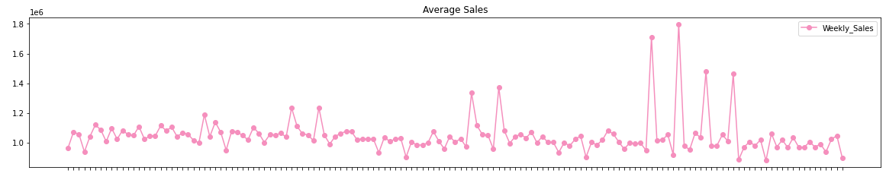
Weekly Sales - Date
Average sales from 2010-02-05 to 2012-11-01
Here the average sales is counted by the sales grouped by date, and calculate the average sales among stores.

Slide 9
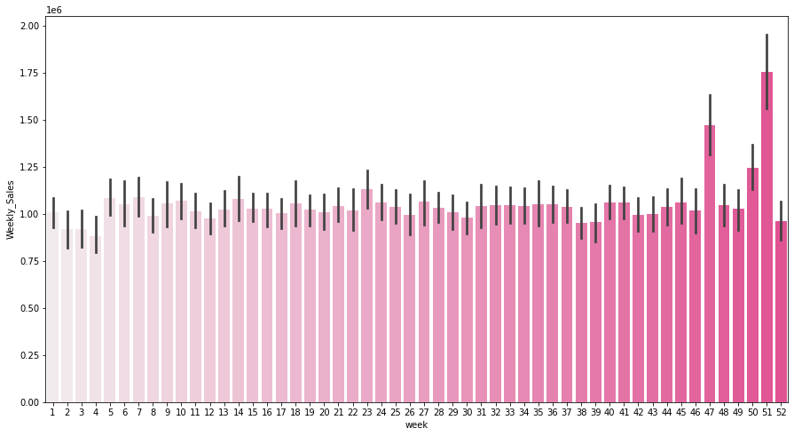
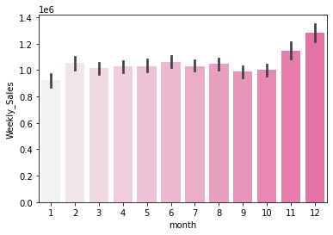
Weekly Sales - Date
histogram of sales versus month
histogram of sales versus week

Slide 10
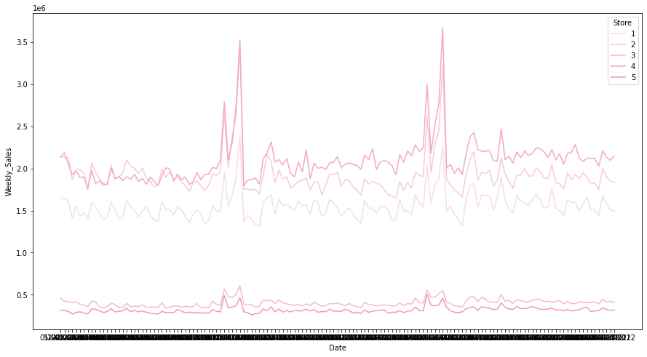
Weekly Sales - Date
Sales of store 1-5 from 2010-02-05 to 2012-11-01

Slide 11
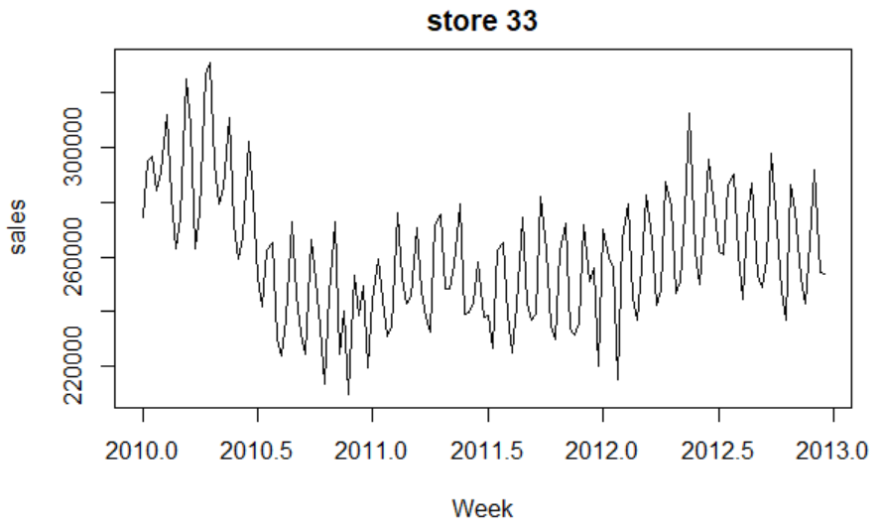
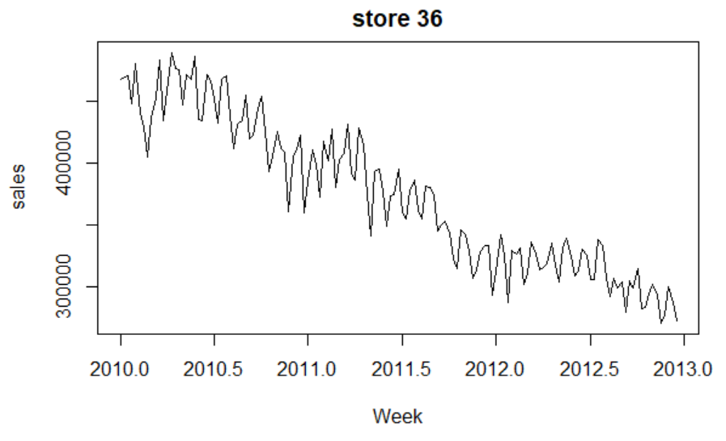
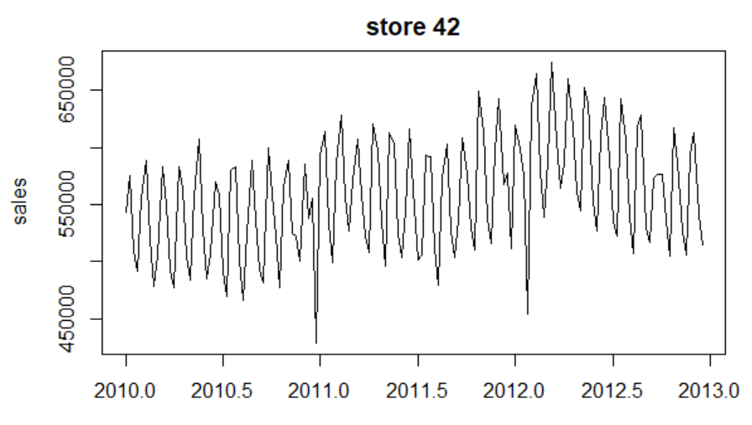
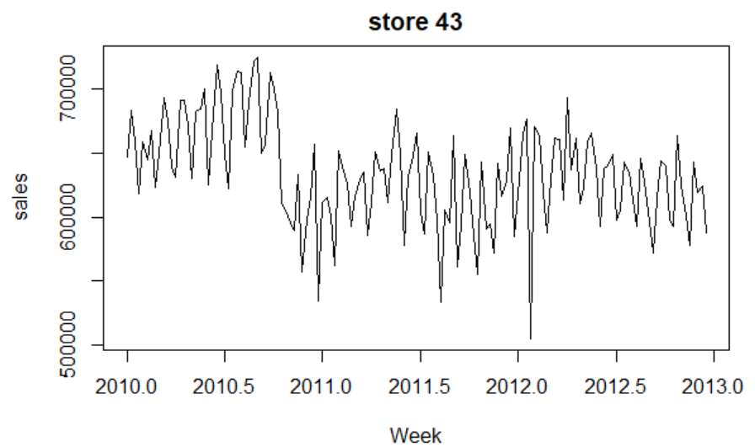
Some different time series plot (store30,33,36,38,43)

Slide 12
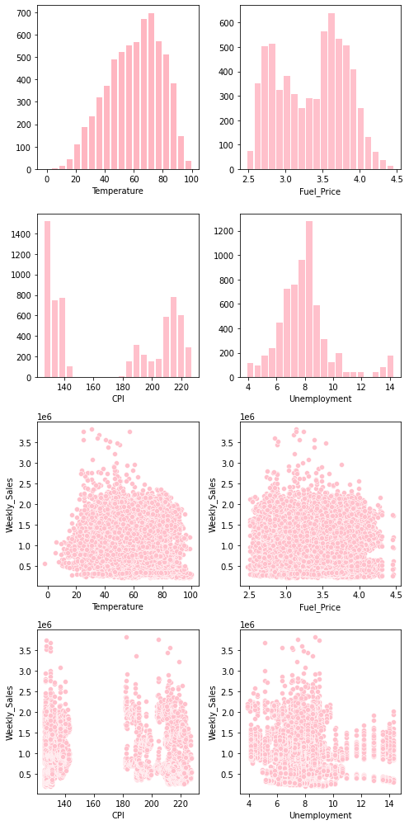
Weekly Sales – Continuous features
Distribution plot
Scatter plot

Slide 13
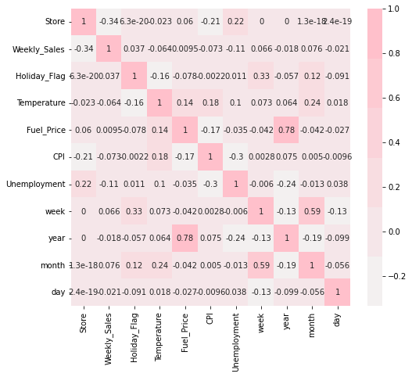
Heatmap

Slide 14
Feature Engineering
missing value: drop
Categorical variable:
Date: divide it into year/month/week
Holiday flag: 0/1 label
feature selection
outlier deduction

Slide 15
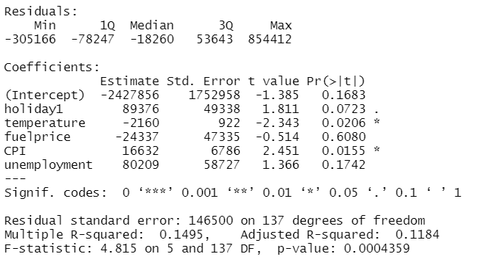
Linear Regression for Store 1
Sales~ holiday + temperature + fuel price + CPI + unemployment

Slide 16
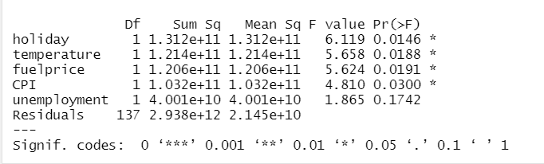
ANOVA table for Store 1

Slide 17
For other Stores Reject H0
H₀: β_{i} = 0 vs H₁: β_{i} ≠ 0
X X^2 logX
holiday : 13 NA NA
temperature: 21 21 19
fuel price: 5 5 4
CPI: 21 21 20
unemployment: 15 15 12

Slide 18
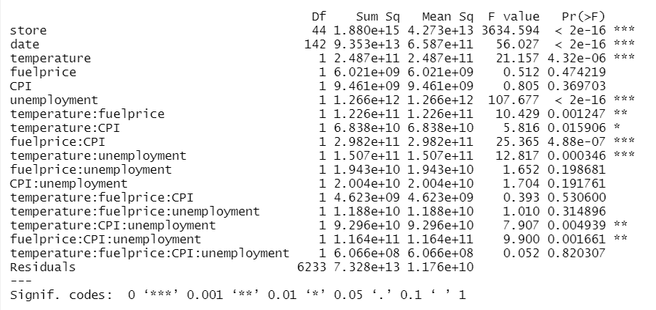
ANOVA for all stores
(Find significant factors and interactions)

Slide 19
Fitted Model
formula = sales ~ store + date + holiday + temperature
+ unemployment + temperature:fuelprice + fuelprice:CPI
+ temperature:unemployment + holiday:temperature:CPI
+ fuelprice:CPI:unemployment

Slide 20
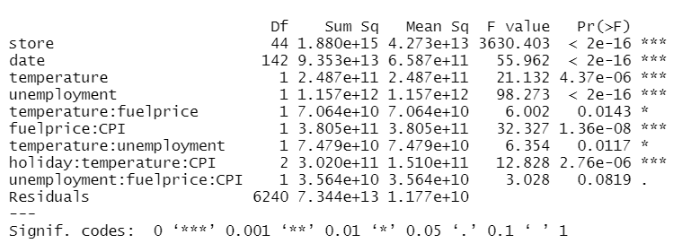
anova table

Slide 21
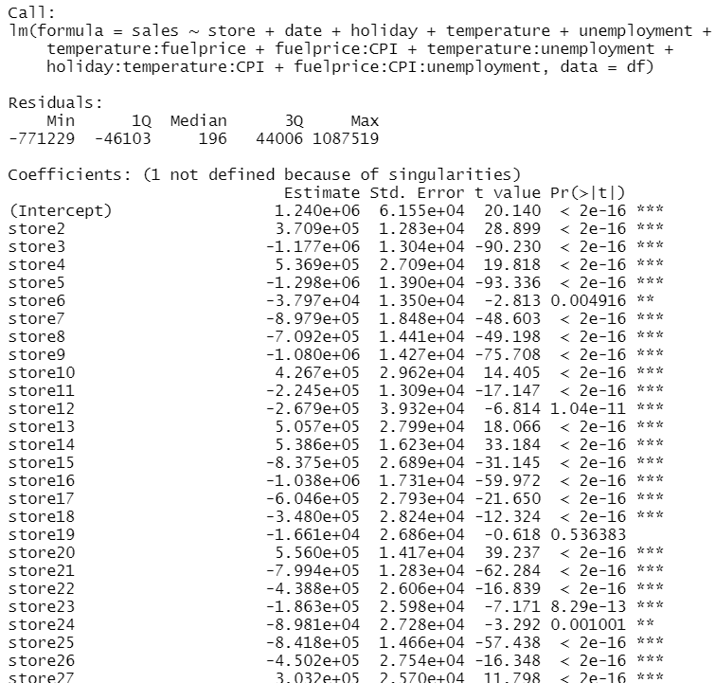
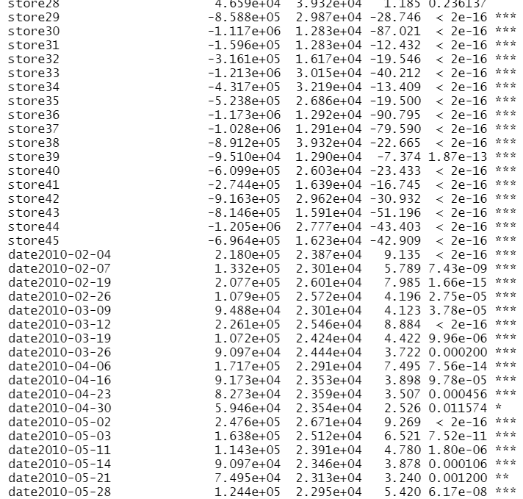
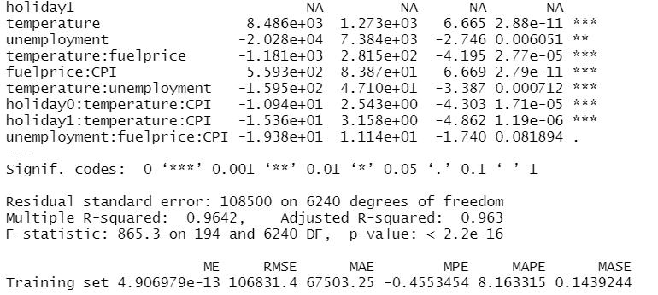

Slide 22
Tree Based method
Data pre-processing
Decision tree regressor
Random forest regressor

Slide 23
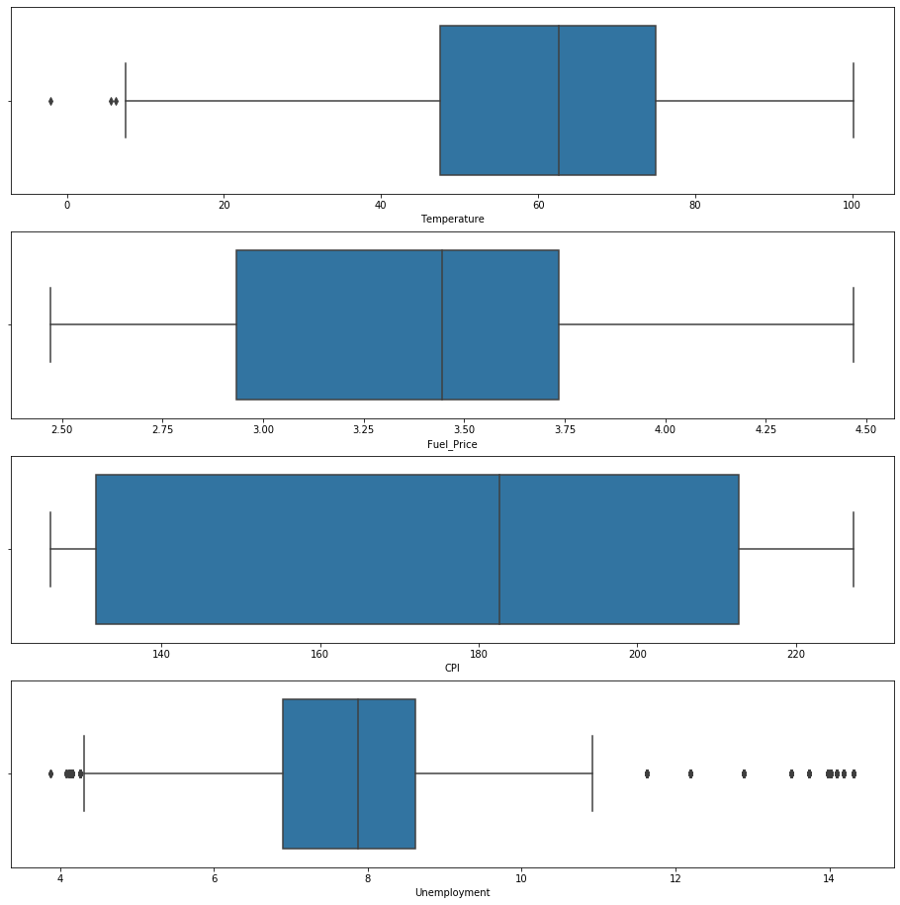
Detecting outliers
Four numerical features
Temperature, Unemployment has outliers

Slide 24
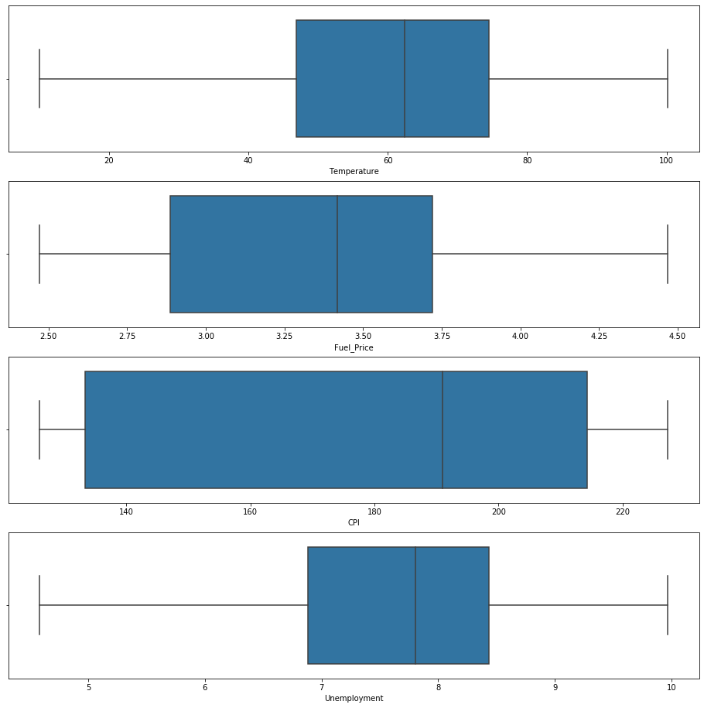
Dropping outliers
4.5 < Unemployment < 10
Temperature > 10

Slide 25
Decision Tree Regressor
Model 1
X = Store, Fuel_Pric, CPI, Unemployment, day, month, year
Y = Weekly_Sales
Model 2
X1 = Store, Holiday_Flag, Temperature, Fuel_Price, CPI, Unemployment, week
Y1 = Weekly_Sales
Model 3
X2 = Store, Holiday_Flag, Temperature, Fuel_Price, CPI, Unemployment, day, month, year
Y2 = Weekly_Sales
Model 4
X3 = Store, Fuel_Price, CPI, Unemployment, week
Y3 = Weekly_Sales

Slide 26
Result
Run each dataset 10 times and collect the mean of the result
 | Model 1 | Model 2 | Model 3 | Model 4
Mean Absolute Error | 93064.97011749116 | 88000.57741784453 | 83553.90086042402 | 90007.57056537102
Mean Squared Error | 38114403683.25368 | 26234356663.645645 | 35680608597.37248 | 25715349607.4352
Root Mean Squared Error | 195182.4103547676 | 161934.62623030384 | 188863.04092204274 | 160336.96776159544

Slide 27
Random Forest Regressor
Set ‘Store’ as a dummy variable
X = Store(1-45), Holiday_Flag , Temperature, Fuel_Price, CPI, Unemployment, Week, day, month, year
Y = Weekly_Sales

Slide 28
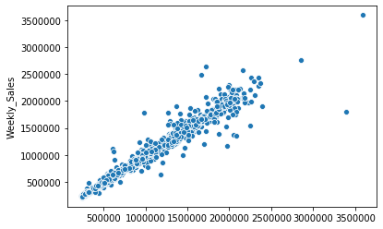
Result
Mean Absolute Error | 62622.03008127209
Mean Squared Error | 13934606067.935745
Root Mean Squared Error | 118044.93241107704
Ytest
Y predict

Slide 29
Model Comparison
 | Linear Regression | Decision Tree Regressor | Random Forest Regressor
Mean Absolute Error | 6.7503e+4 | 9.0007e+4 | 6.2622e+4
Mean Squared Error | 1.176e+10 | 2.5715e+10 | 1.3934e+10
Root Mean Squared Error | 1.06831e+5 | 1.6033e+5 | 1.18044e+5

Slide 30
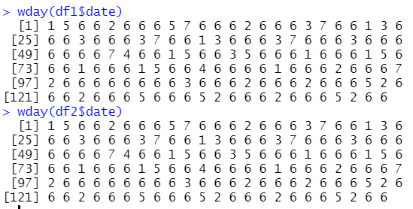
Discussion

Slide 31

Discussion

Slide 32
Reference
https://www.kaggle.com/rutuspatel/walmart-dataset-retail

